Slide 1
AI/ML assisted biomolecule optimization in gene editing
Jiangchuan Ye, PhD

Slide 2
Agenda
Gene editing NGS platform
Protein engineering
mRNA sequence optimization

Slide 3






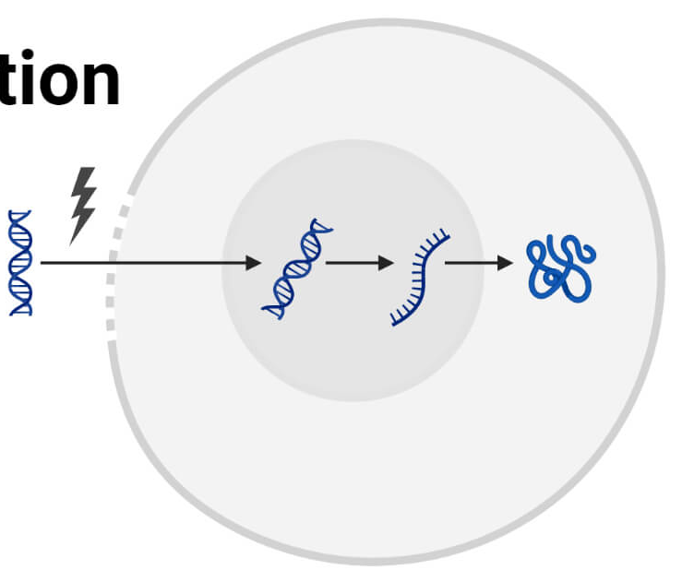
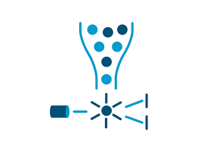
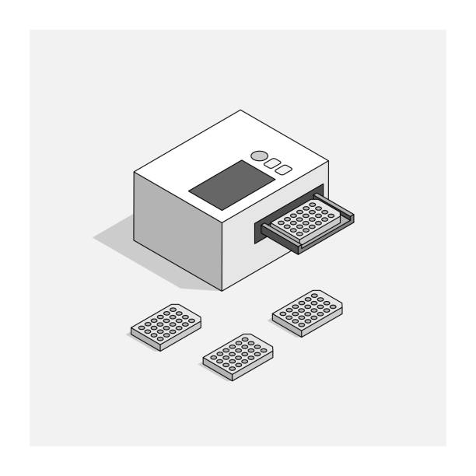

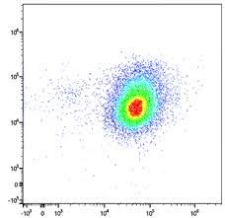
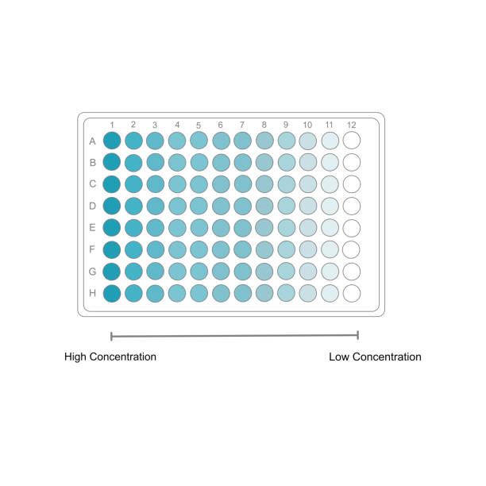
Gene editing screening platform
LNP
Electroporation
NGS-based on targeting efficiency assessment
Off-targeting prediction and assay
Guide design and evaluation
Deliver cargo into cell of interest
In vivo study
Cell-based phenotypic readout
(FACS, qPCR, ELISA, etc.)
Notes:
I developed the NGS data analysis platform

Slide 4
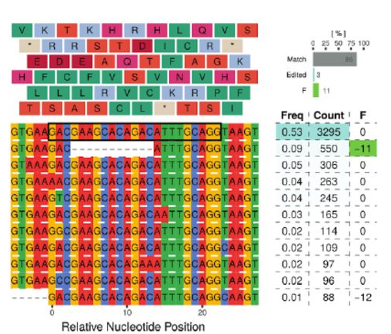
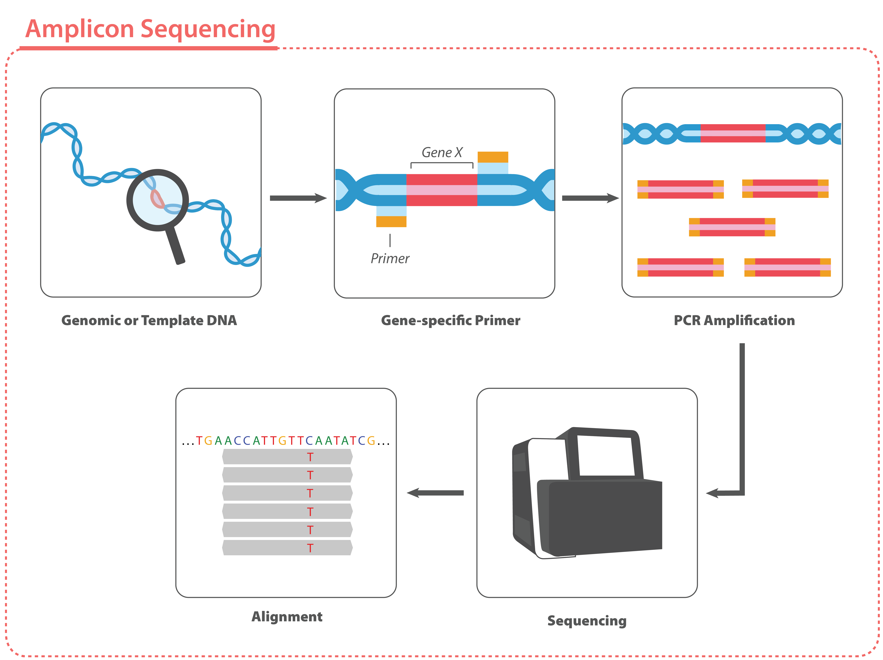
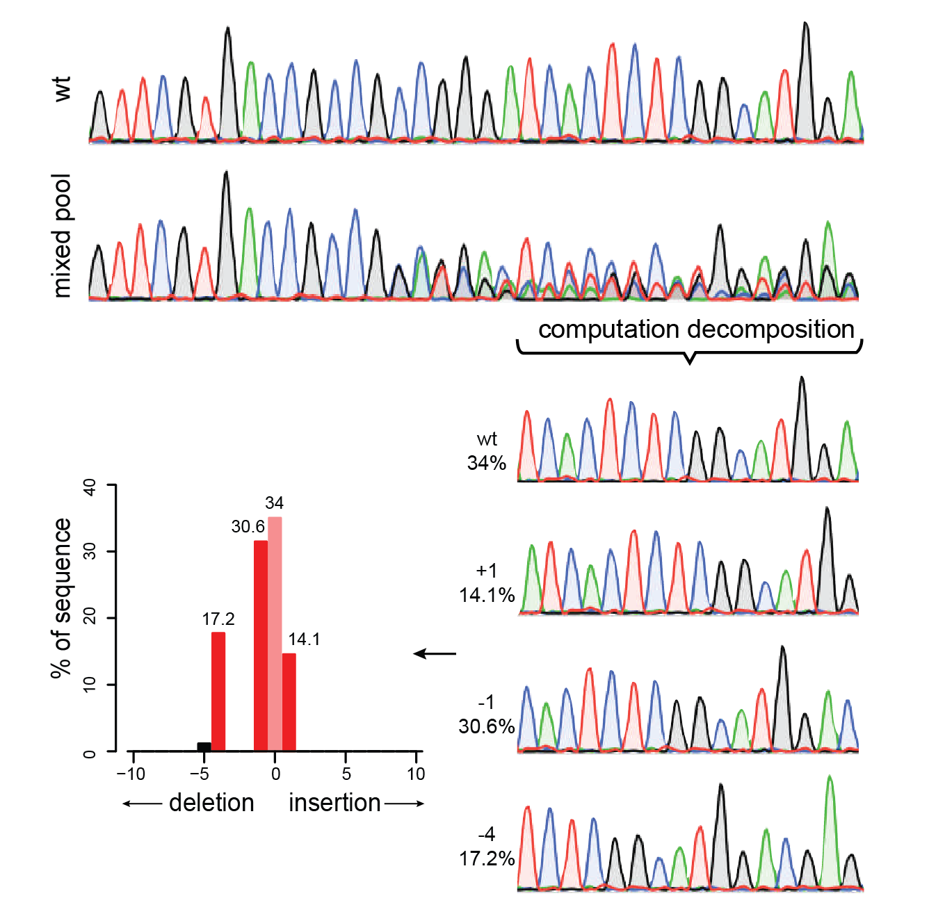
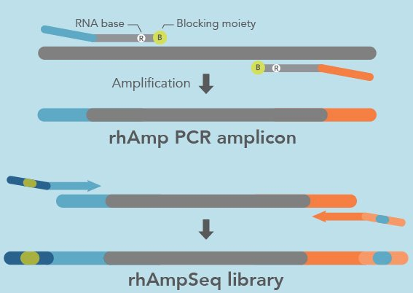
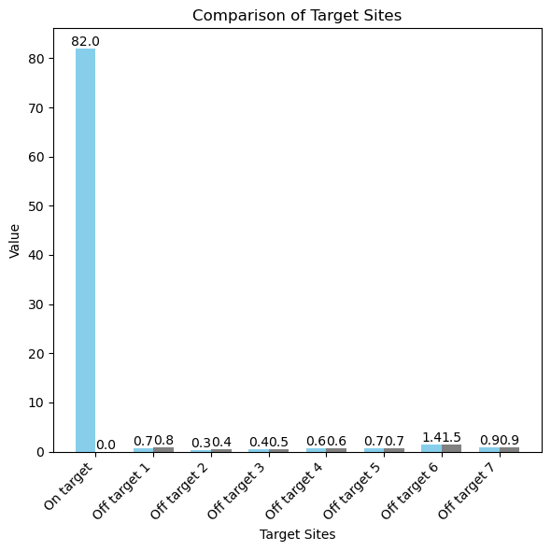
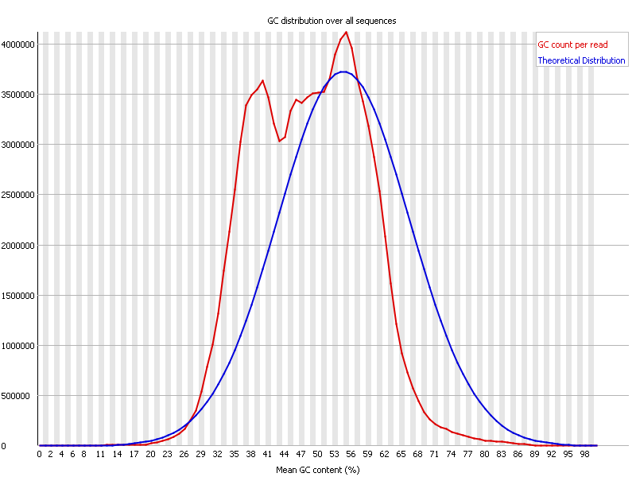
NGS analysis development
Editing result
Amplicon sequencing
TIDE
rhAMP-seq
rhAMP-seq result
Sequencing reads
Edited
Control
Kit 1
Kit 2

Slide 5
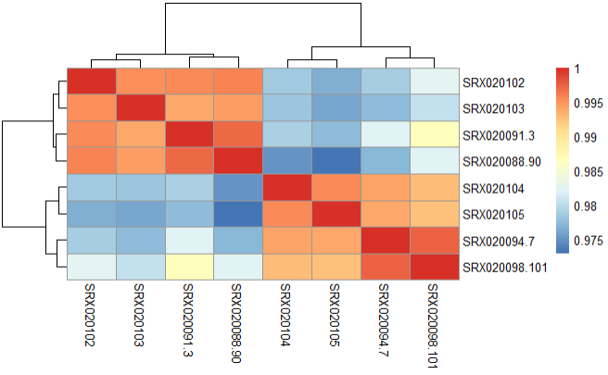
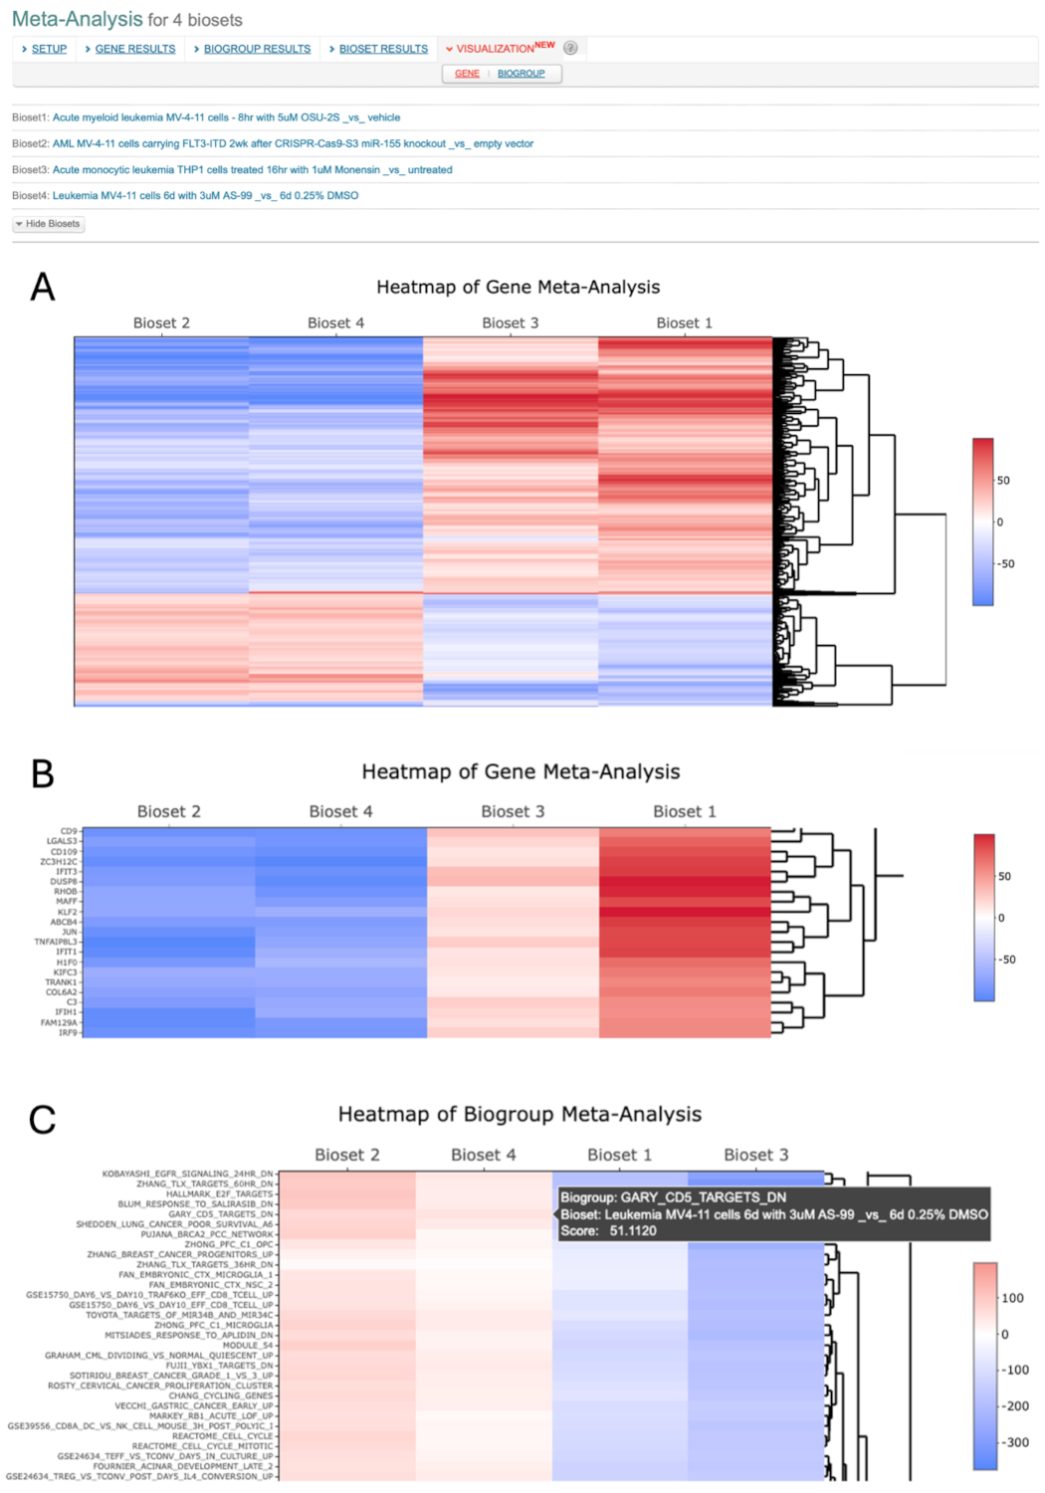
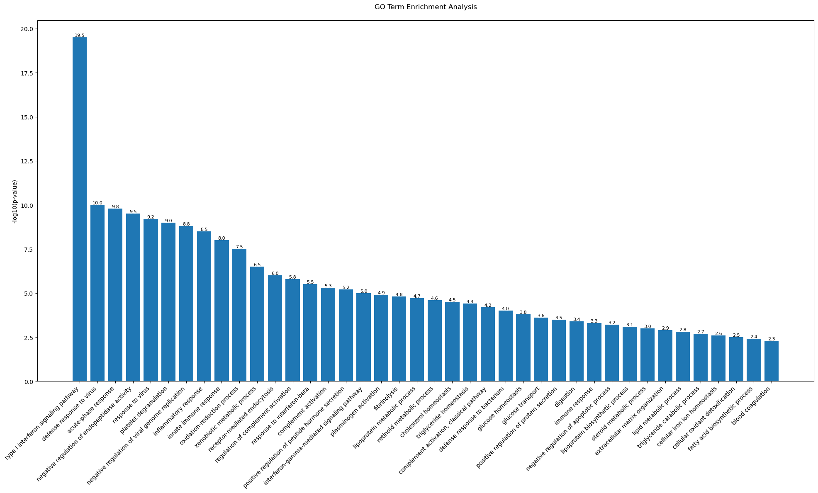
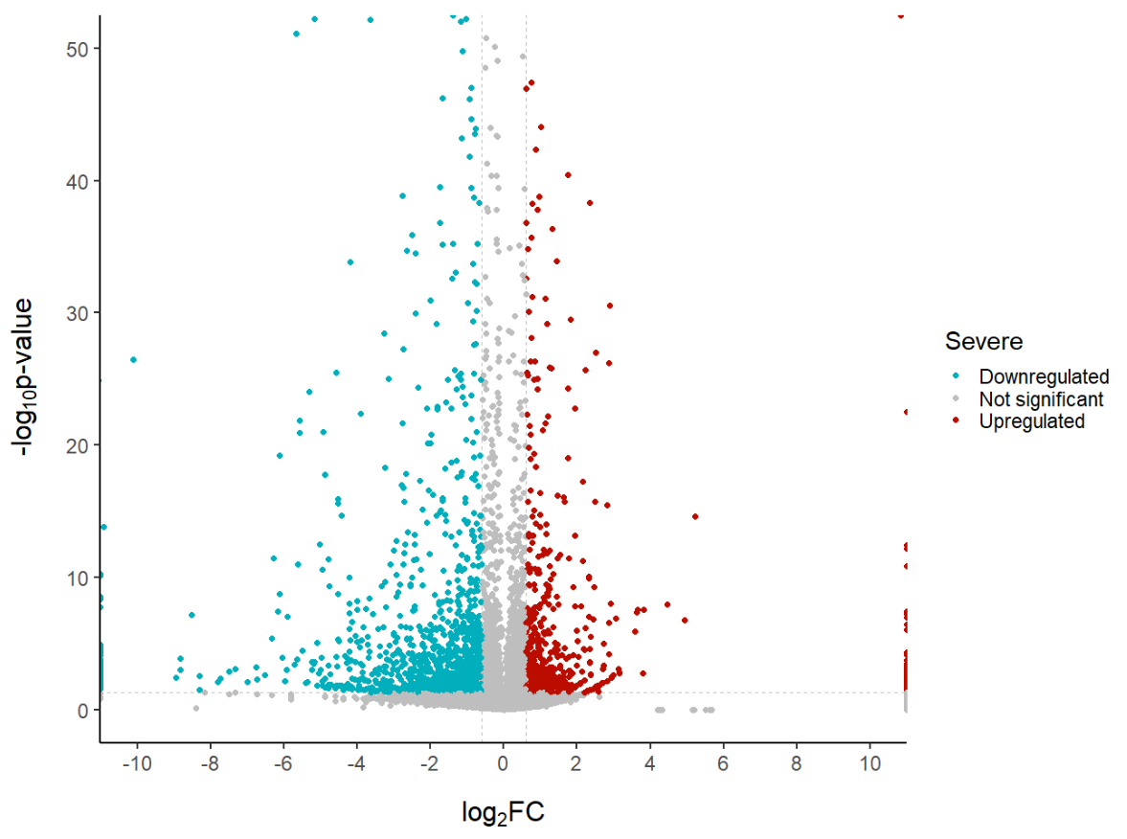
Omics study (RNA-seq)
Sample distance
Expression heatmap (HVG)
cont1
cont2
cont3
cont4
Treat1
Treat2
Treat3
Treat4
Pathway analysis

Slide 6
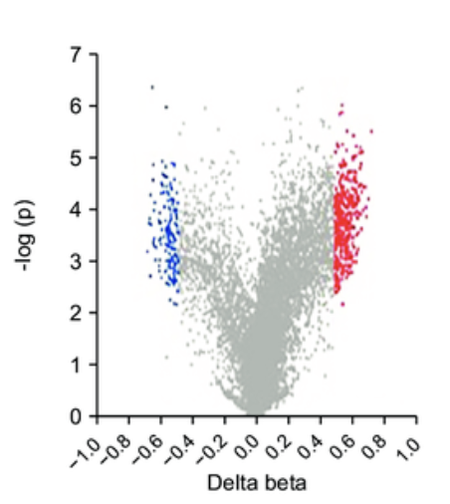
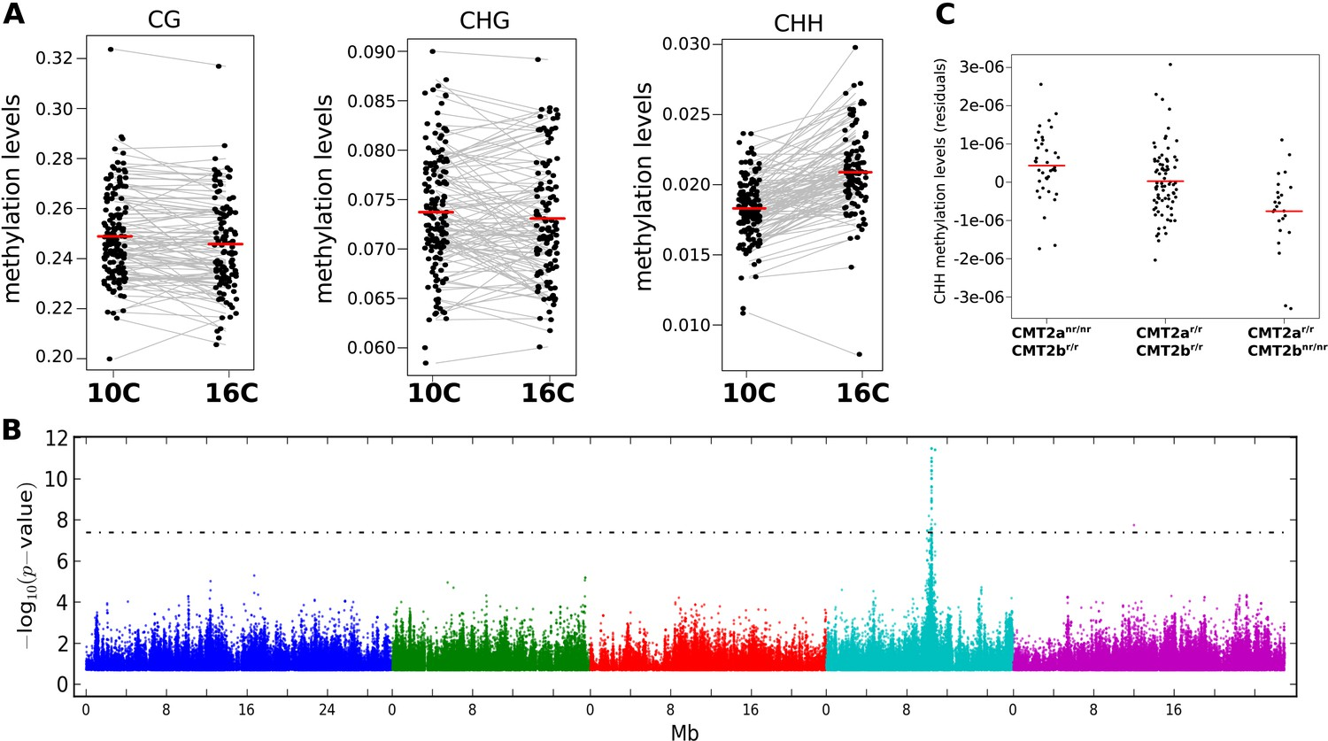
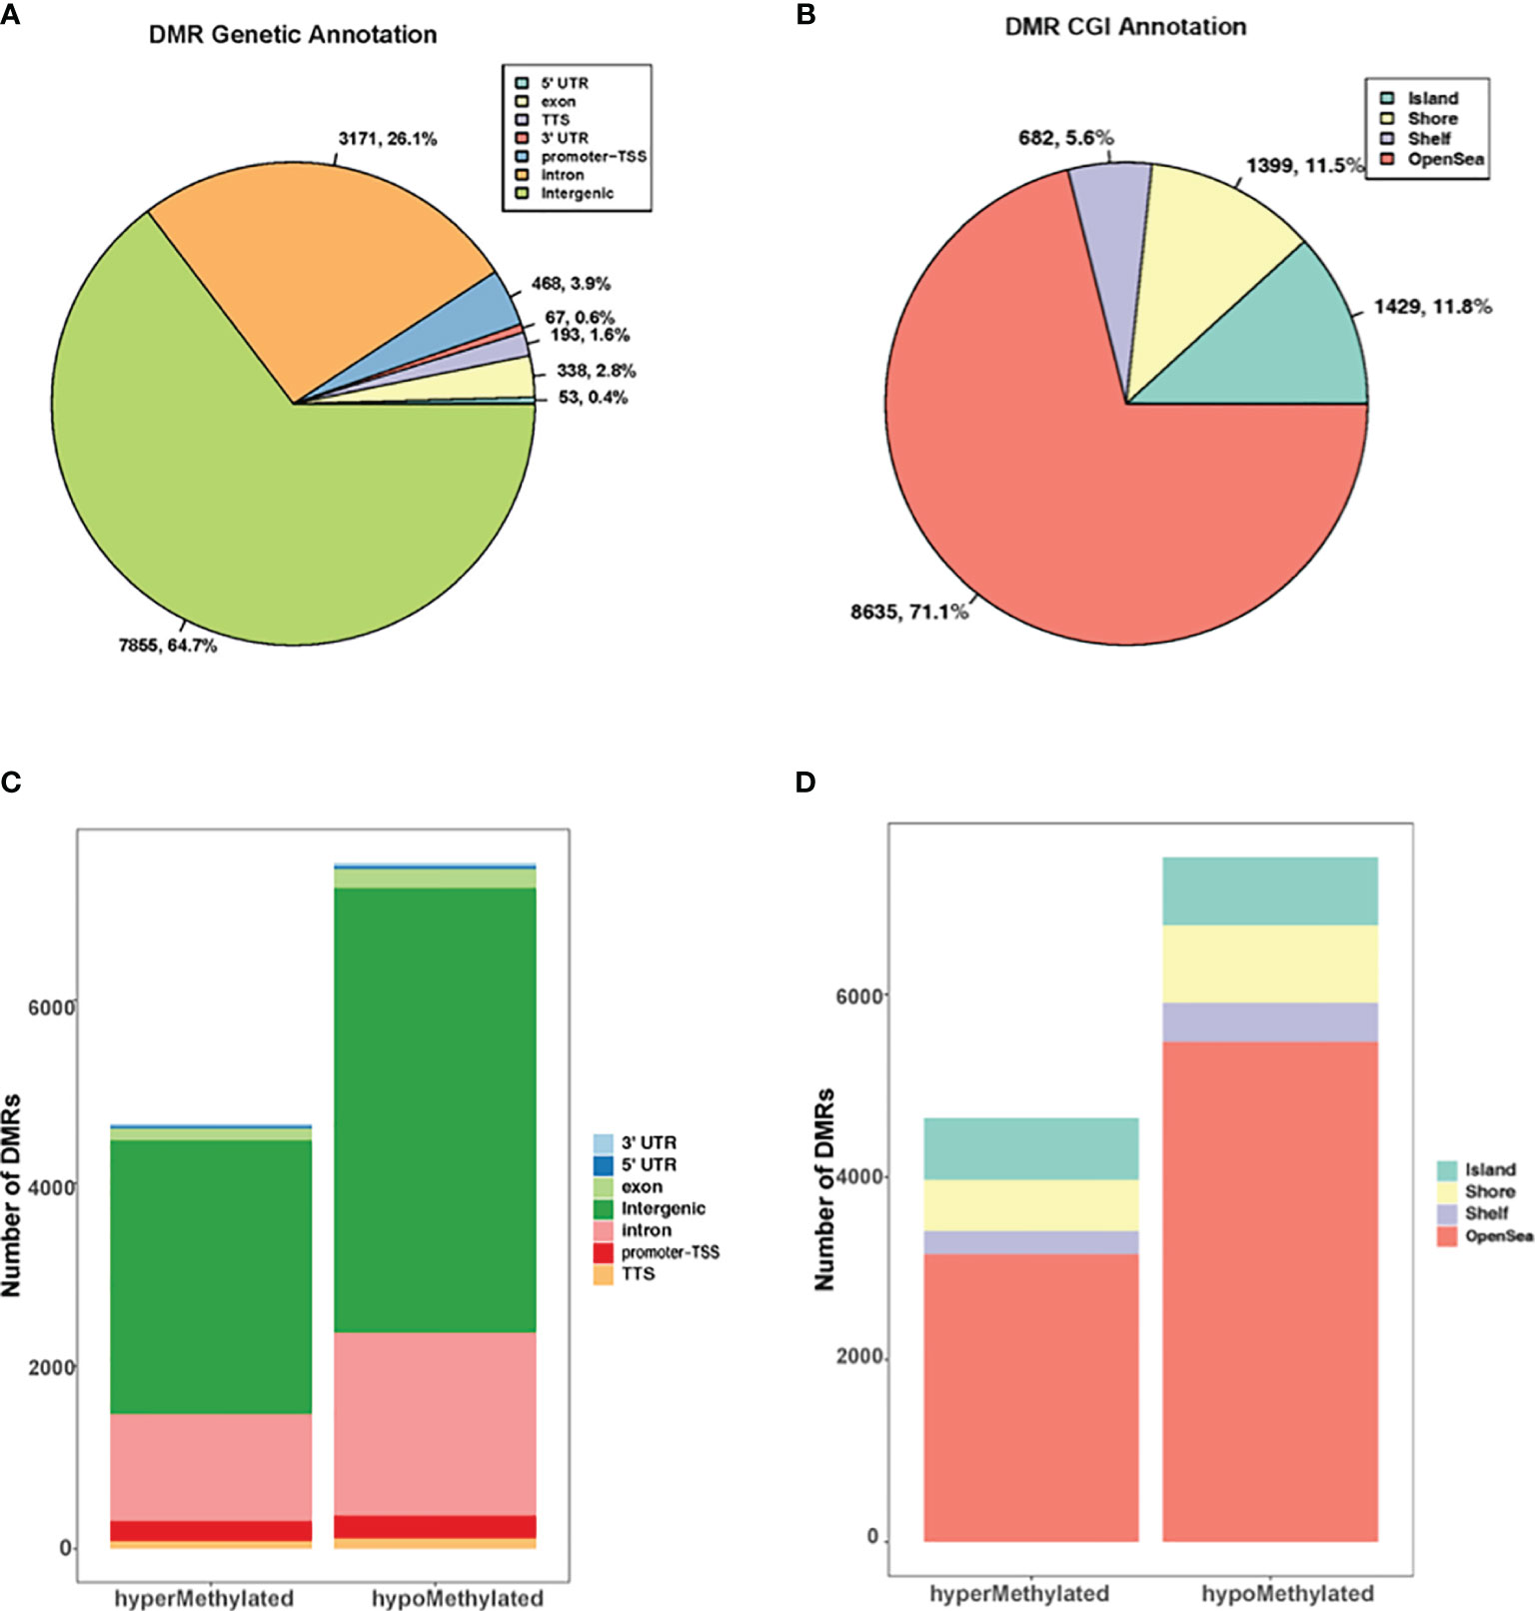
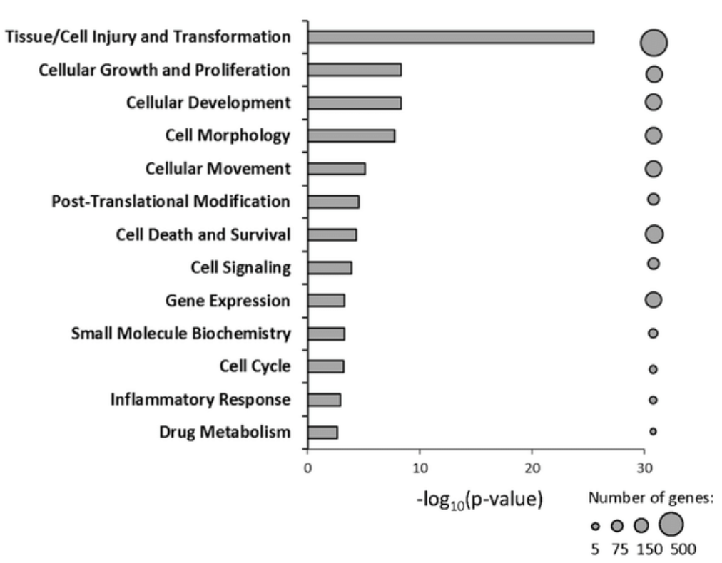
Omics study (Methyl-seq)
Differentially methylated regions (DMR)
Genome wide CpG methylation alteration (edited samples)
Only target region has strong differential methylation
DMR annotation
CpG annotation
DMR associated pathways (hypermethylation)

Slide 7
Agenda
Gene editing NGS platform
Protein engineering
mRNA sequence optimization

Slide 8
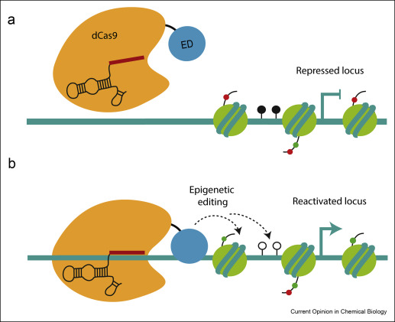
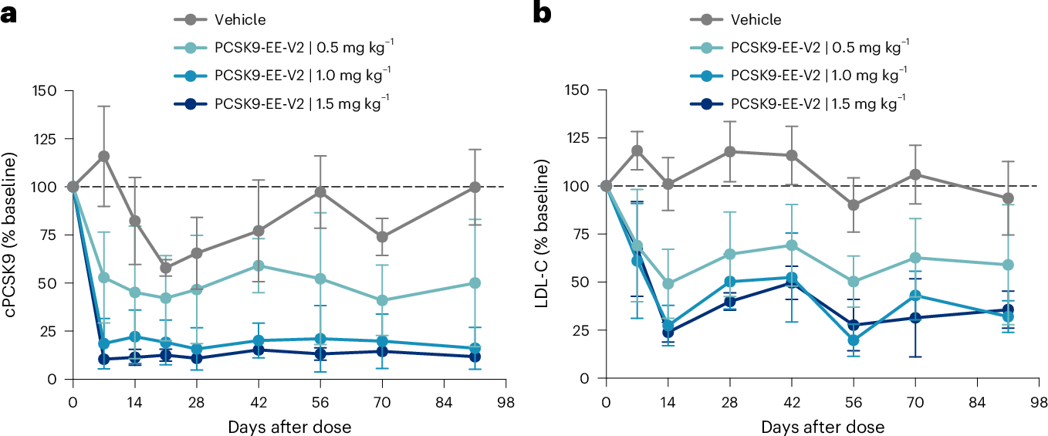


Optimizing protein sequence for epi-genetic editor
DNMT3A
dCas9
ED
Epigenetic editor inactivates gene by
installing methylation on promoter
Chroma Medicine 2025

Slide 9
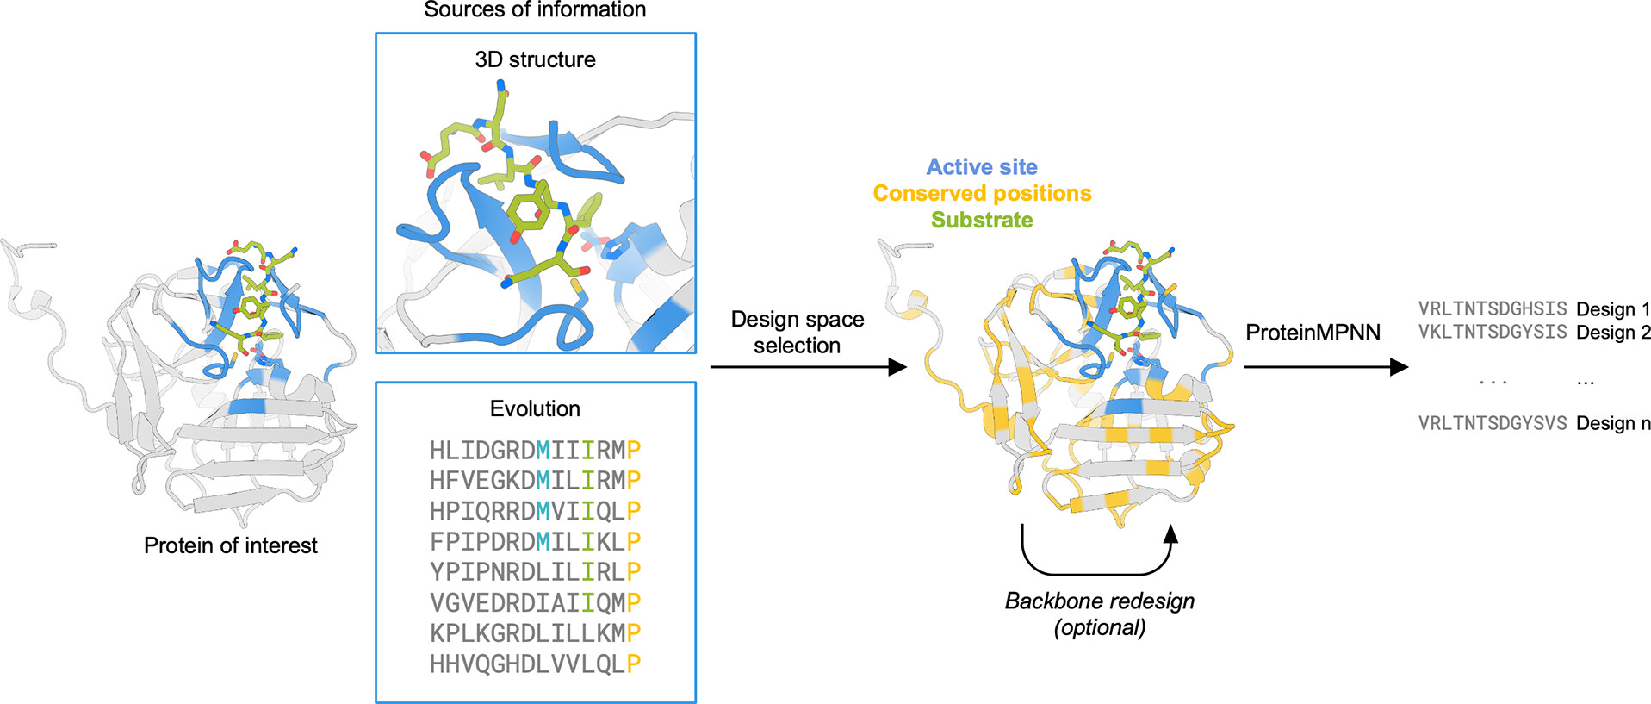
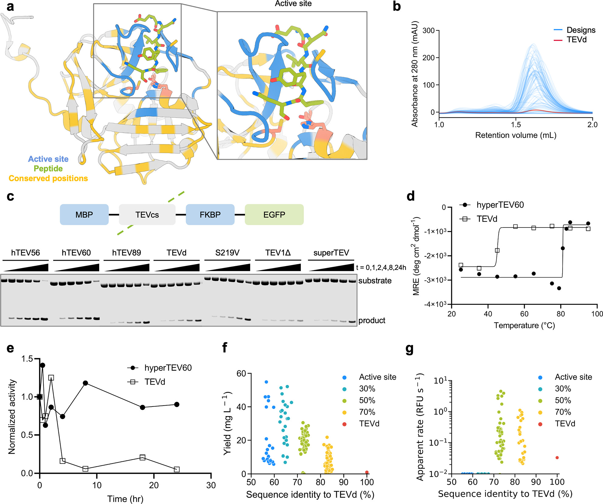
Structure-based enzyme optimization (an example)
Yield
Activity
Thermostability
Sumida et al JACS 2024
Notes:
molar residue ellipticity

Slide 10
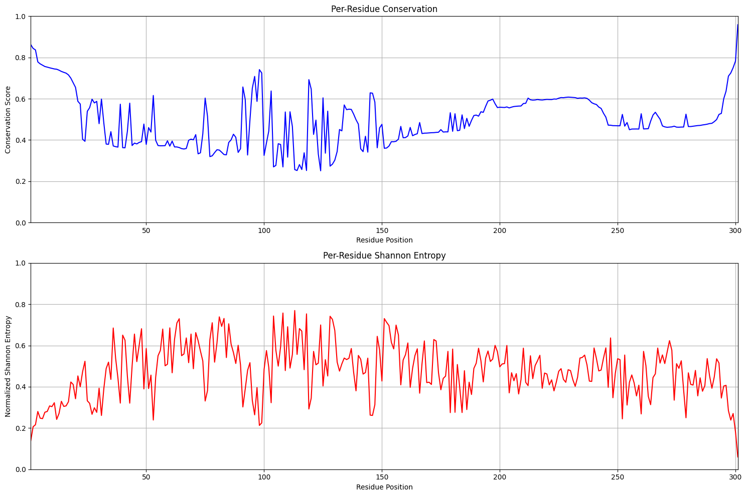
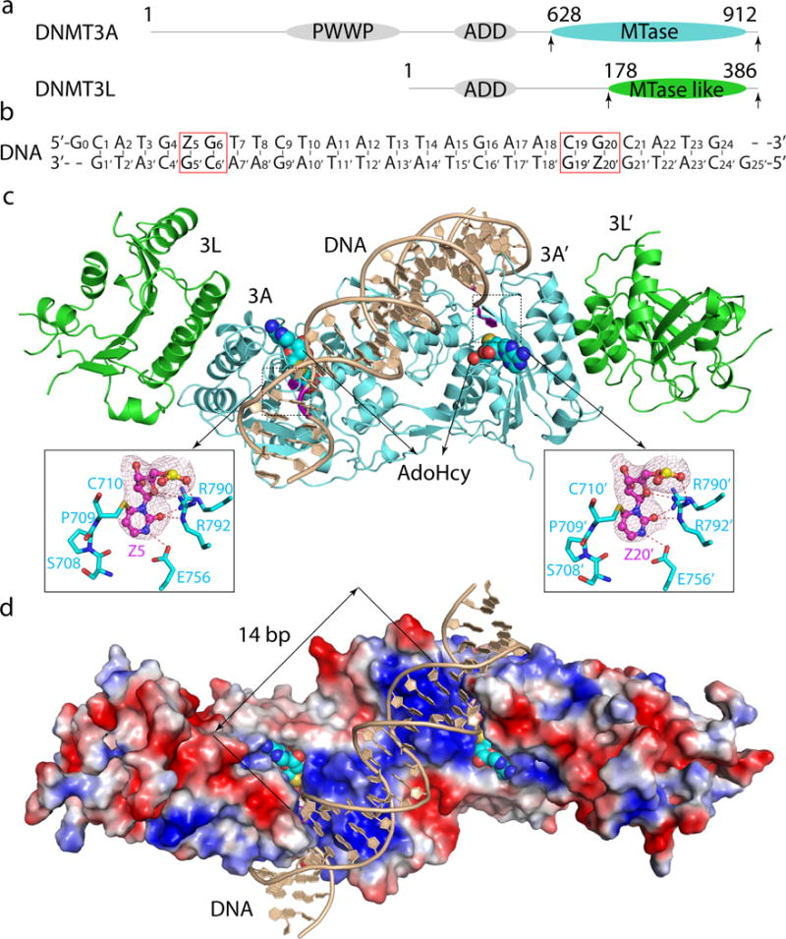
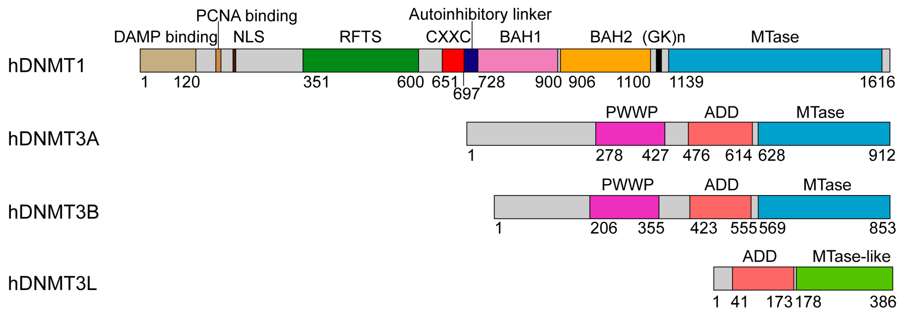
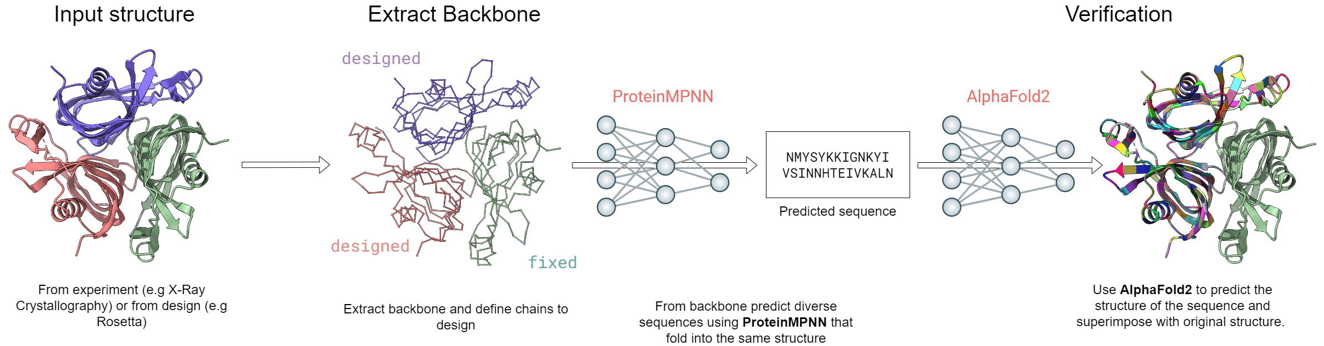
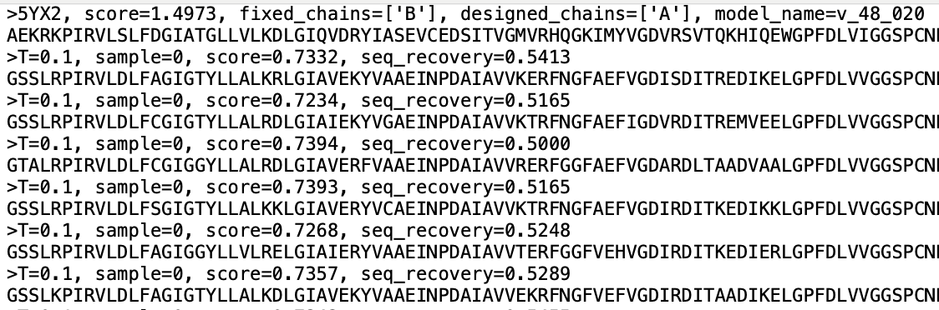
Structure-based design
Conservation score (MMSeqs2)
DNMT3A structure
Domain information
Sequence generation

Slide 11
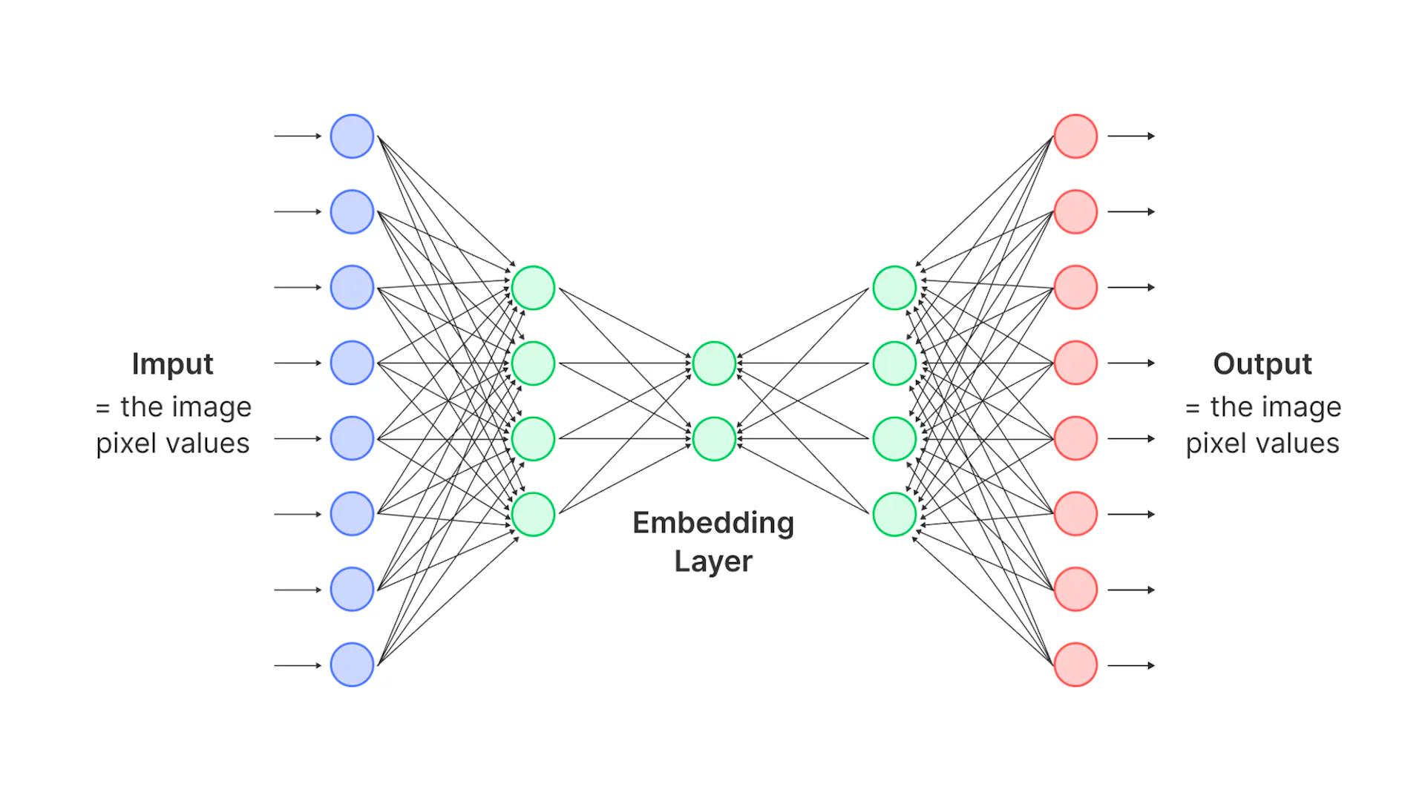
Protein language model-based design
pLM
Input sequence
Log-likelihood (fitness)
MGILERVVRRNGRVDRSLKDECDTAEKKAKVIAGMNAVEENQGPGESQKVEEASPPAVQQPTDPASPTVATTPEPVGSDAGDKNATKAGDDE….
𝛥LLR
Mutant nomination
Tokenization
softmax
Greedy adaptive walk (N steps)
Notes:
iterative walk steadily lowers the sequence perplexity; once it enters that band, every remaining single substitution looks neutral or deleterious, so the greedy search naturally halts.
Reach a local optimum for single‑mutant moves.

Slide 12
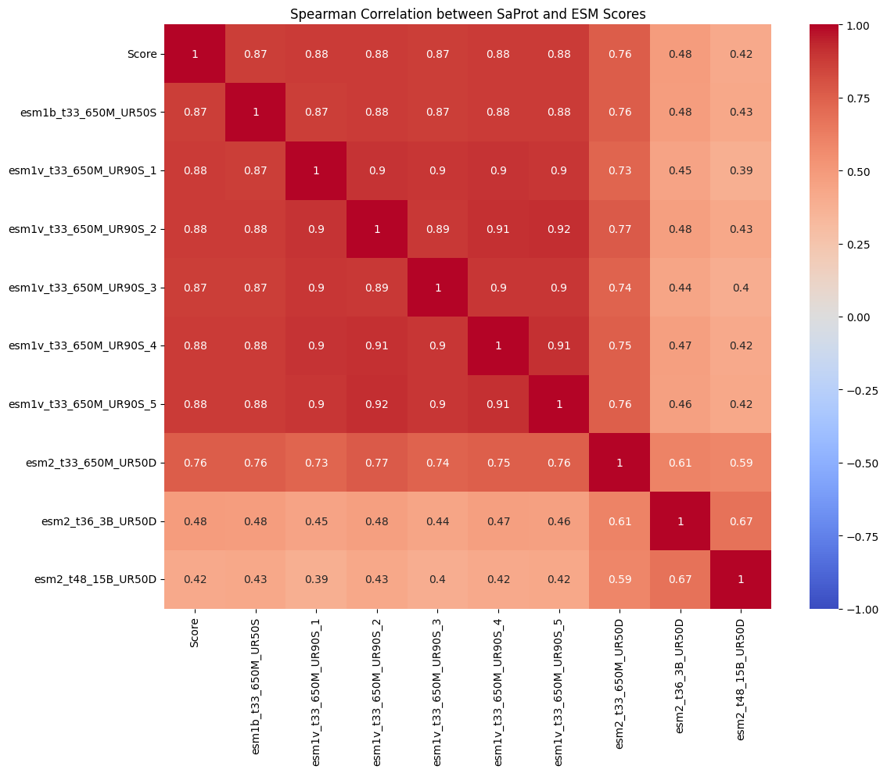
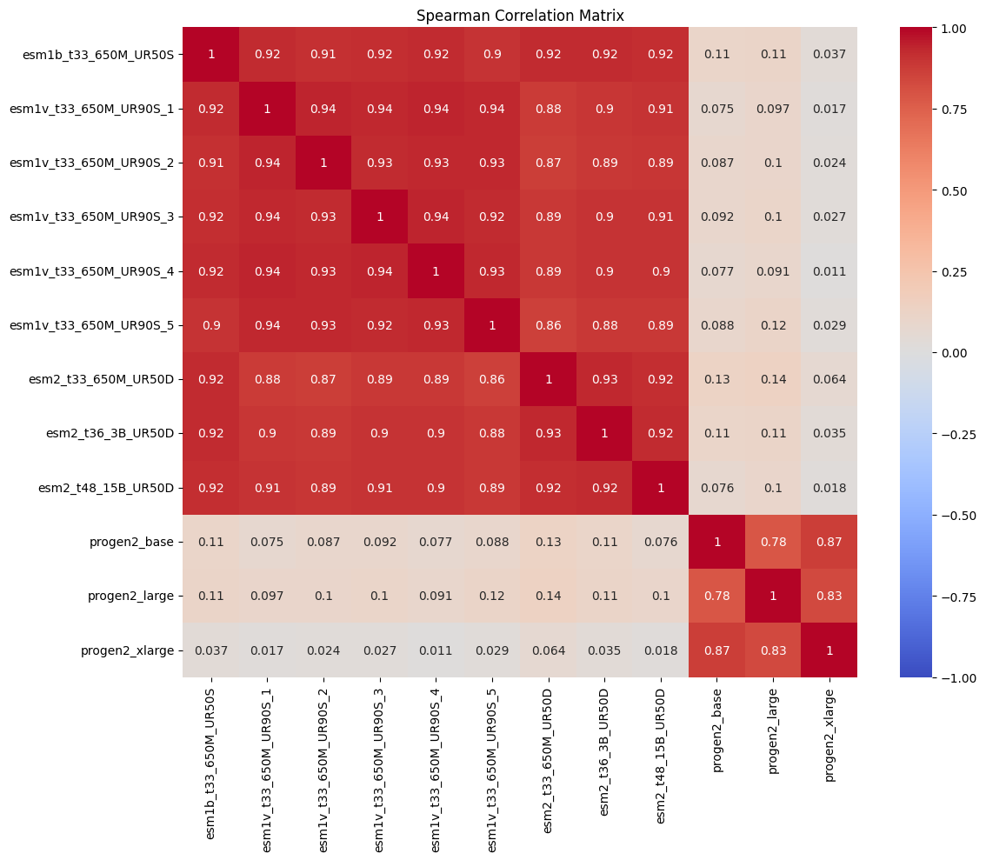
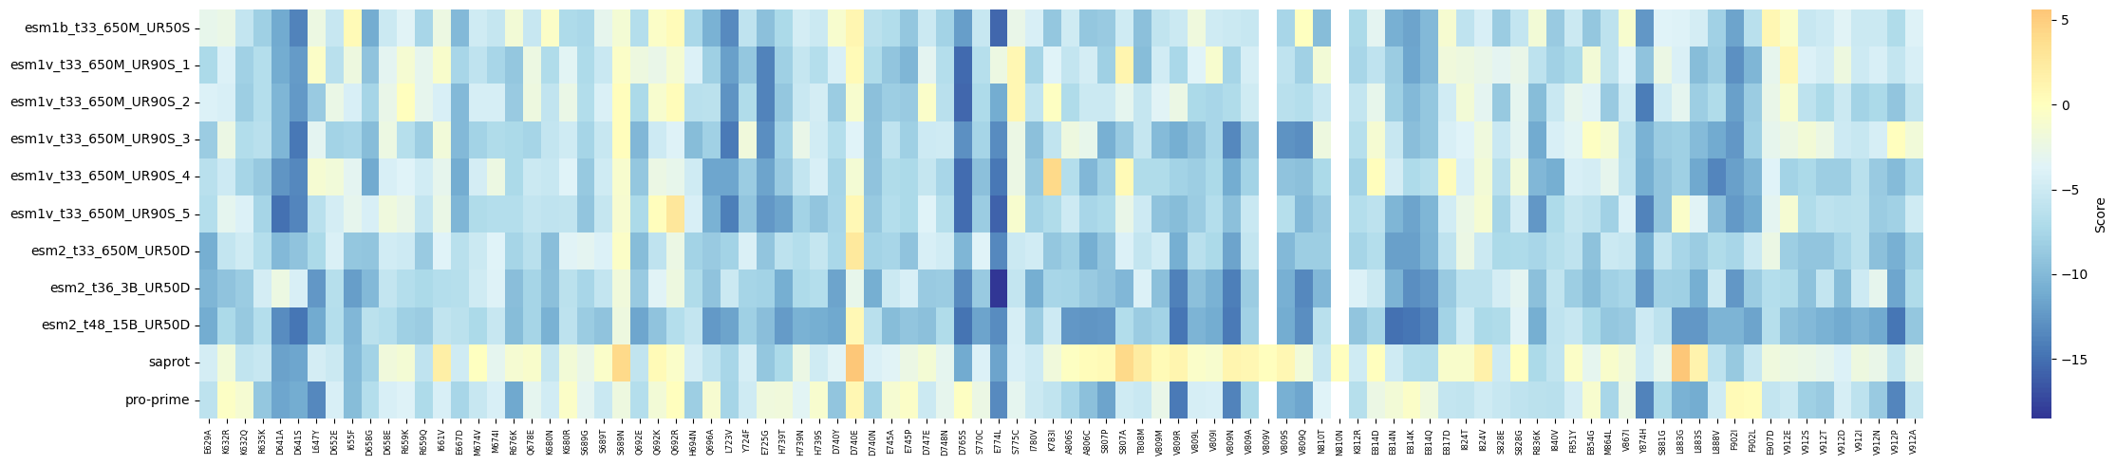
Usage of multiple pLMs
ESM-SaProt
SaProt
Feature | ESM2 | Progen2 | SaProt | Pro-Prime
Training Data | UniRef50, UniRef90, and other UniProt datasets. | A diverse set of over one billion protein sequences from genomic, metagenomic, and immune repertoire databases. | ~40 million protein sequences and their corresponding 3D structures (from AlphaFold DB). | Datasets with temperature information for organisms (e.g., proteins from organisms with known optimal growth temperatures).
Model Architecture | Transformer Encoder (BERT-like) | Autoregressive Transformer (GPT-like) | Transformer Encoder (based on ESM-2 architecture) | Transformer Encoder (based on ESM-2 650M)
Parameters | 8M, 35M, 150M, 650M, 3B, 15B | 151M, 764M, 2.7B, 6.4B | 650M | Based on ESM-2 650M
Training Goal | Masked Language Modeling (MLM) | Next-Token Prediction: Generates a protein sequence one amino acid at a time, from left to right. | Masked "Structure-Aware" Token Prediction: Predicts masked tokens that represent both amino acid and structural state. | Temperature-Guided Masked Language Modeling: MLM with a focus on predicting residues in proteins with known temperature stability.
SaProt
ESM-ProGen
Consensus voting for candidate nomination

Slide 13
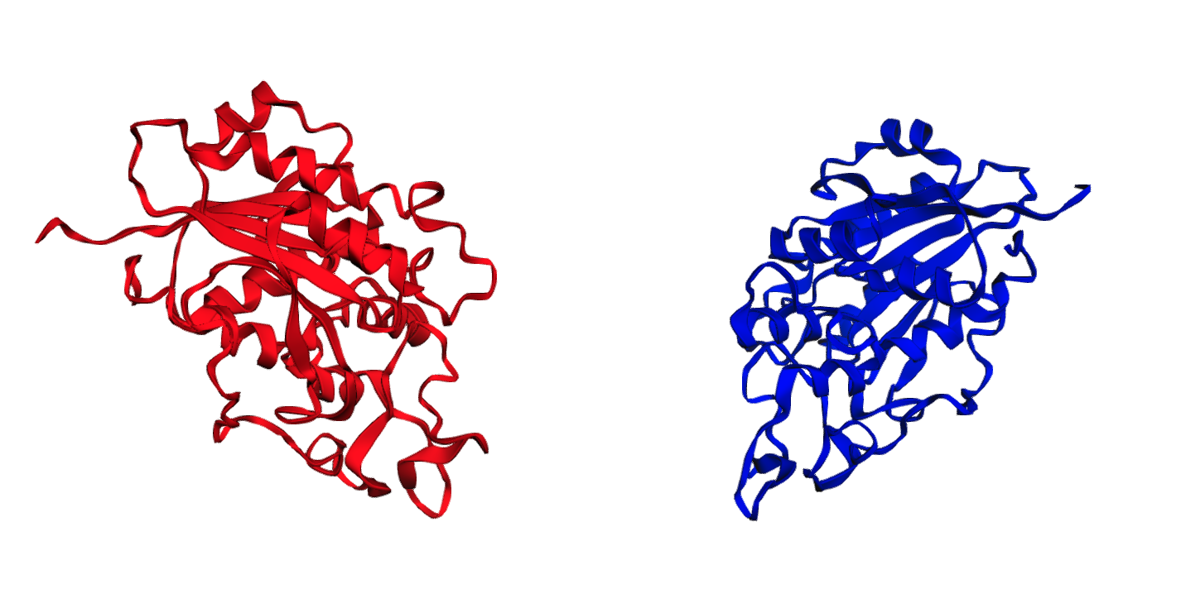
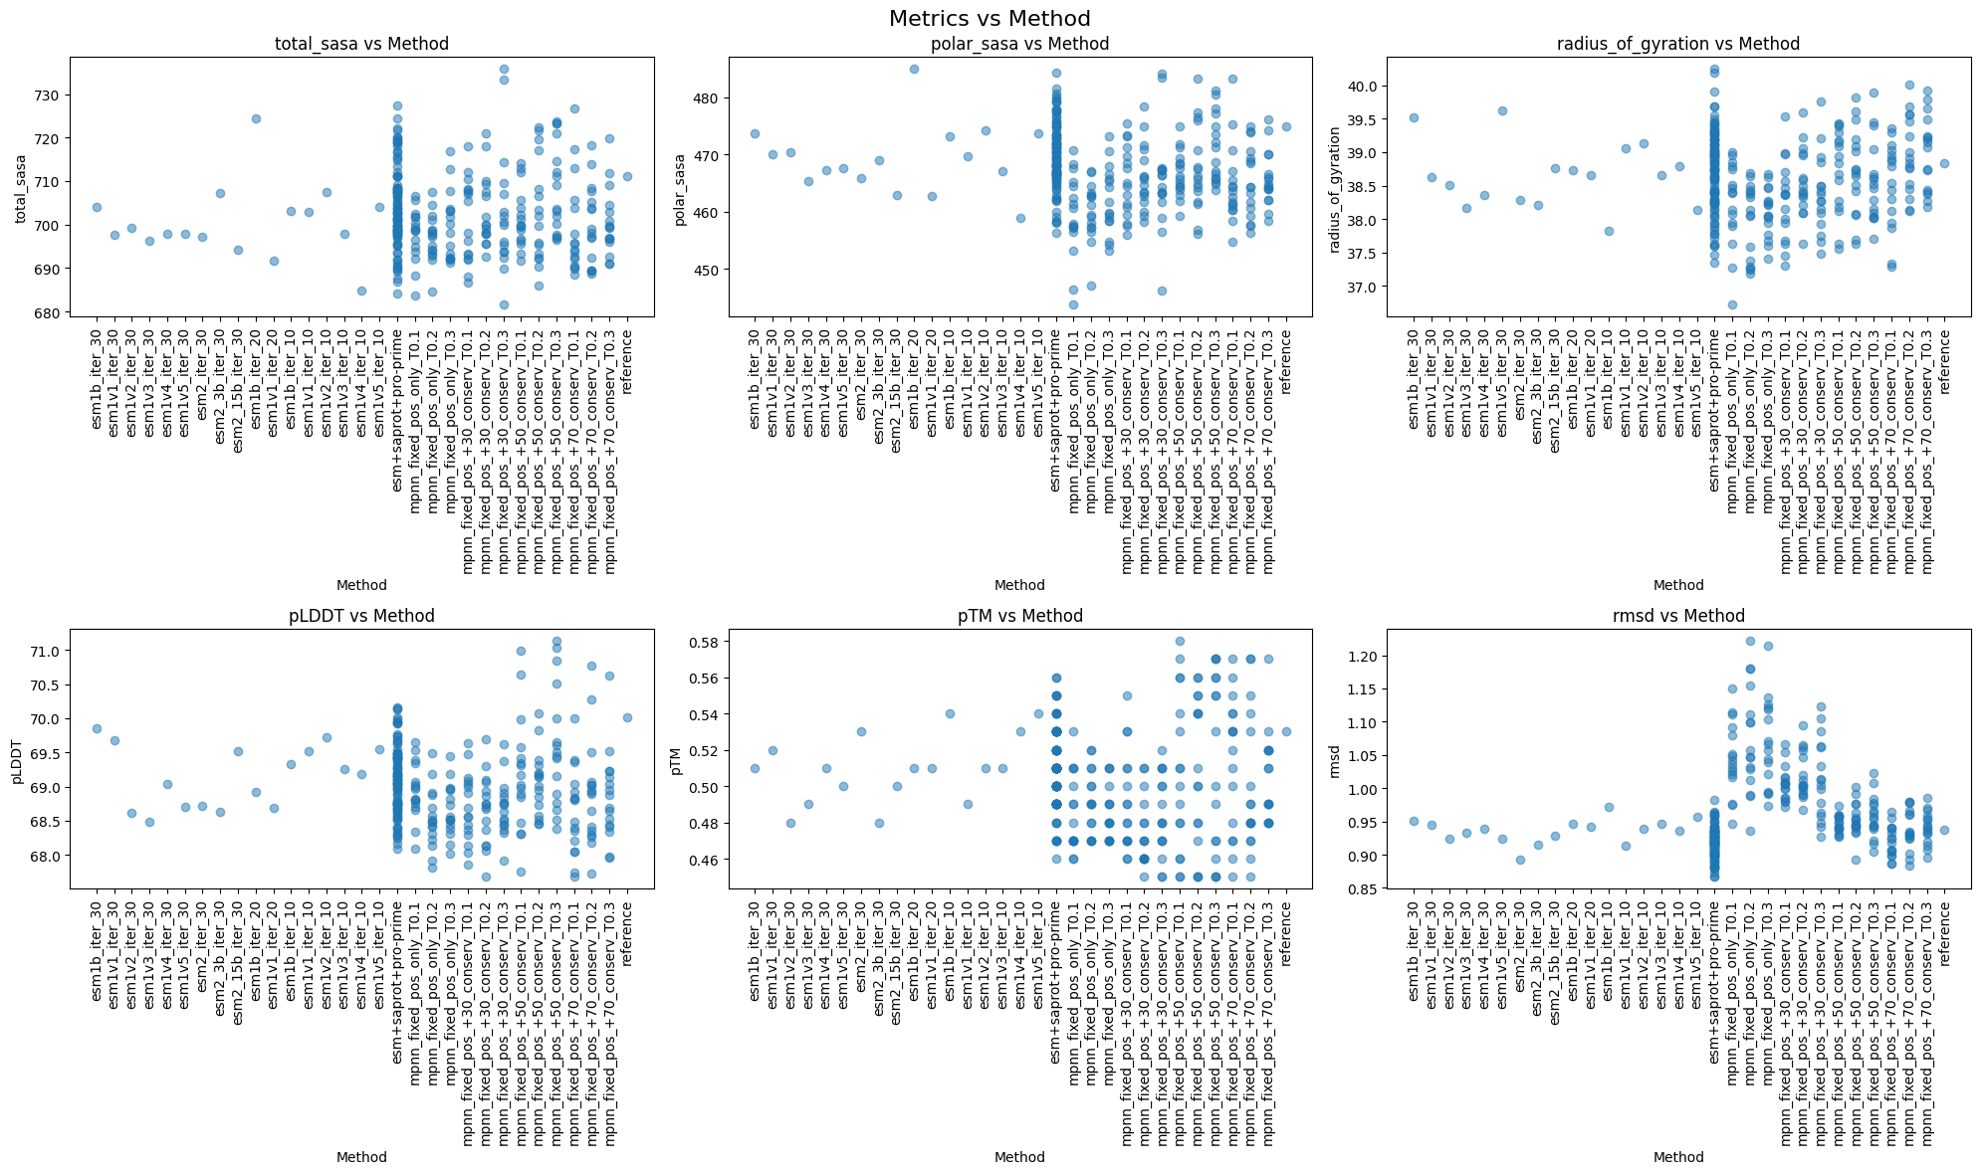
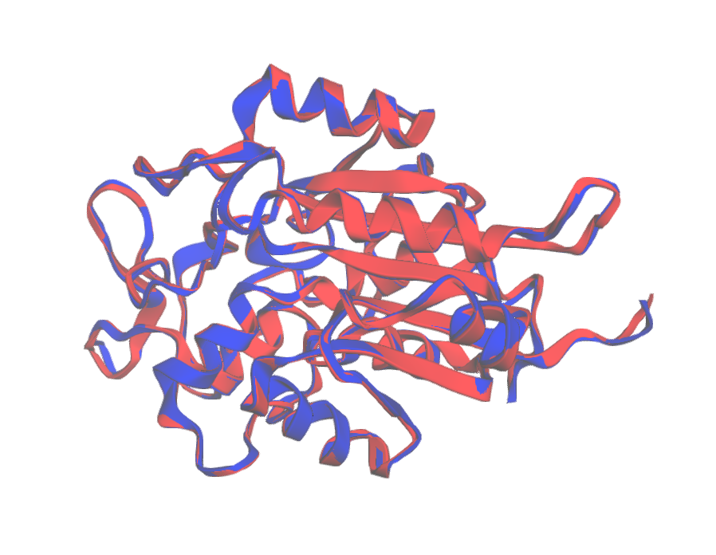
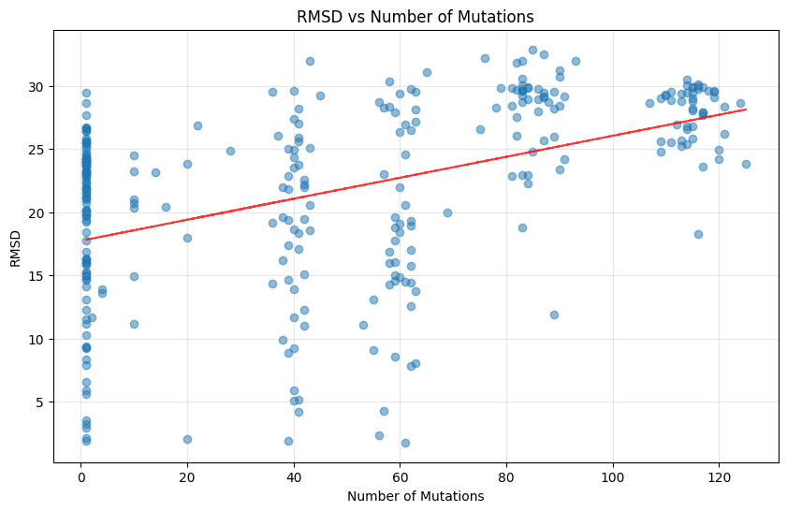
Sequence filtering and selection
Original pdb
Generated (modeled by AF2)
Superimposed
Notes:
how spread out or condensed the protein's structure is

Slide 14
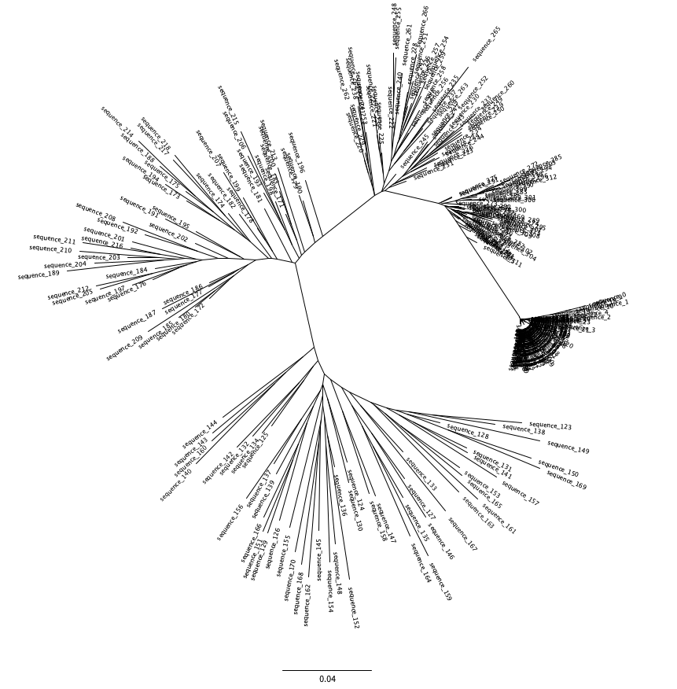
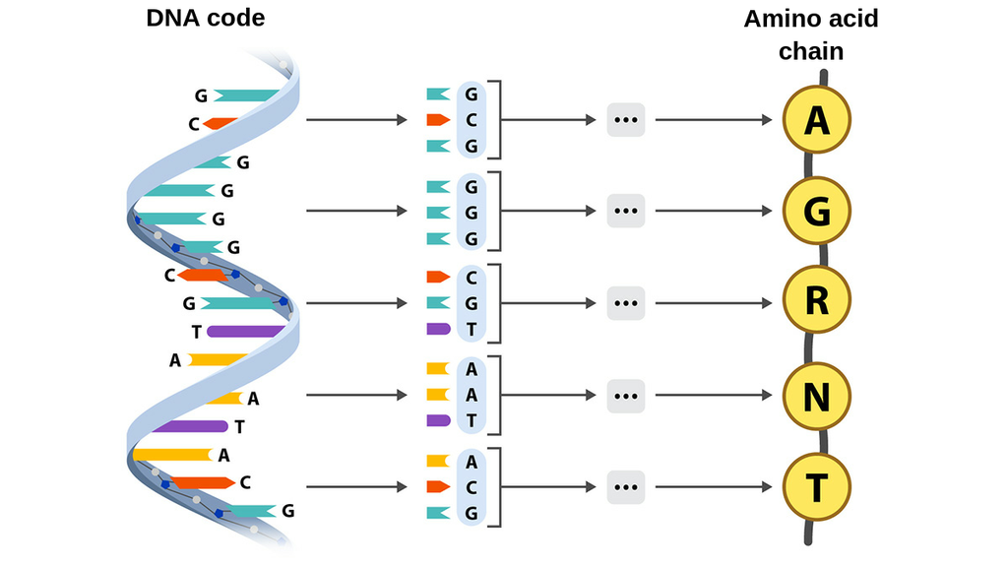
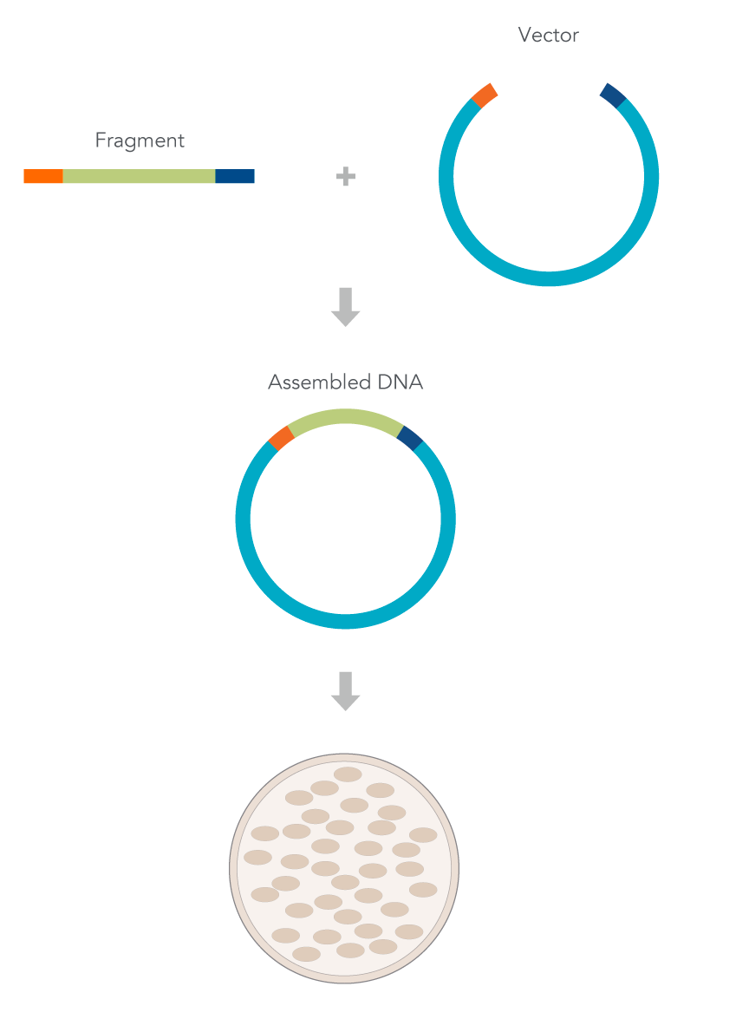
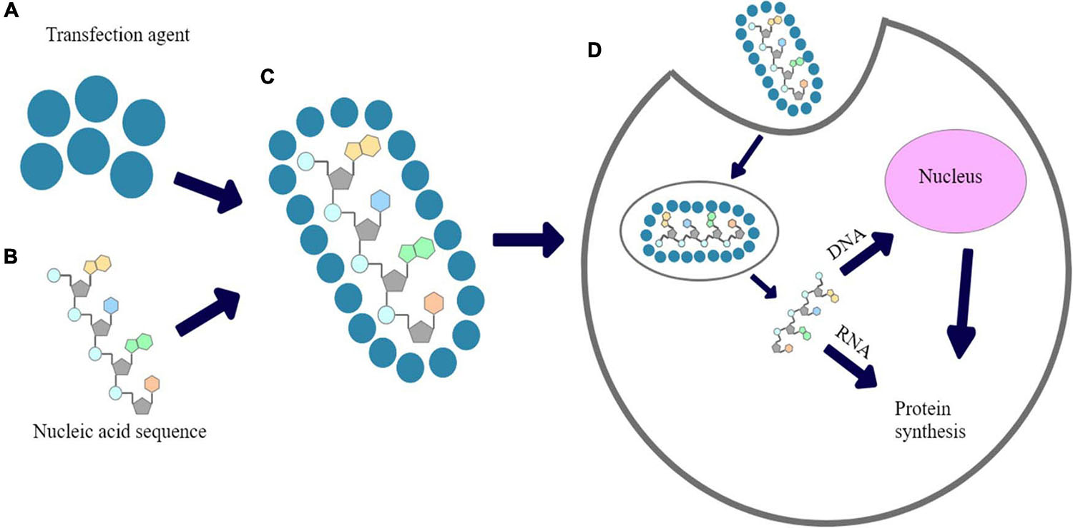

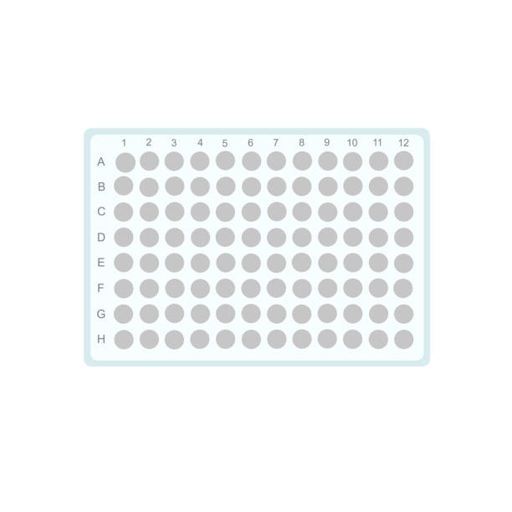
Sequence pooling and experimental validation
MPNN_fixed_pos+50% conservation (48)
MPNN_fixed_pos+30% conservation (48)
MPNN_fixed_pos+70% conservation (48)
Greedy adaptive walk (17)
Original
Single mutants (94)
MPNN_fixed_pos (48)

Slide 15
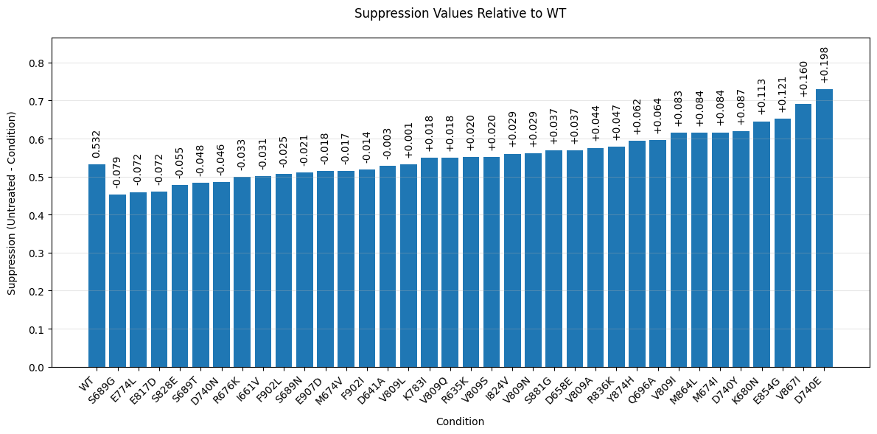
Sequence pooling and experimental validation
Enzymatic activity readout
Next steps:
Structural modeling in complex
Rosetta energy analysis
Molecular dynamics
Visual inspection (clash, complementarity, etc.)
%Untreated
Notes:
D → E: extends side-chain reach, possibly forming a new or stronger salt bridge and/or repositioning active-site loops.
D → Y: Although the negative charge is lost, an aromatic ring can create ππ-ππ or cation-ππ interactions (particularly if Arg or Lys is nearby), and the phenolic OH can do limited hydrogen bonding. This partially improves activity but not as strongly as a well-placed negative charge.
D → N: Removes the negative charge and replaces it with a smaller, neutral side chain that doesn’t form strong electrostatic or aromatic interactions. No net benefit—and possibly some disruption if the original negative charge was important.

Slide 16
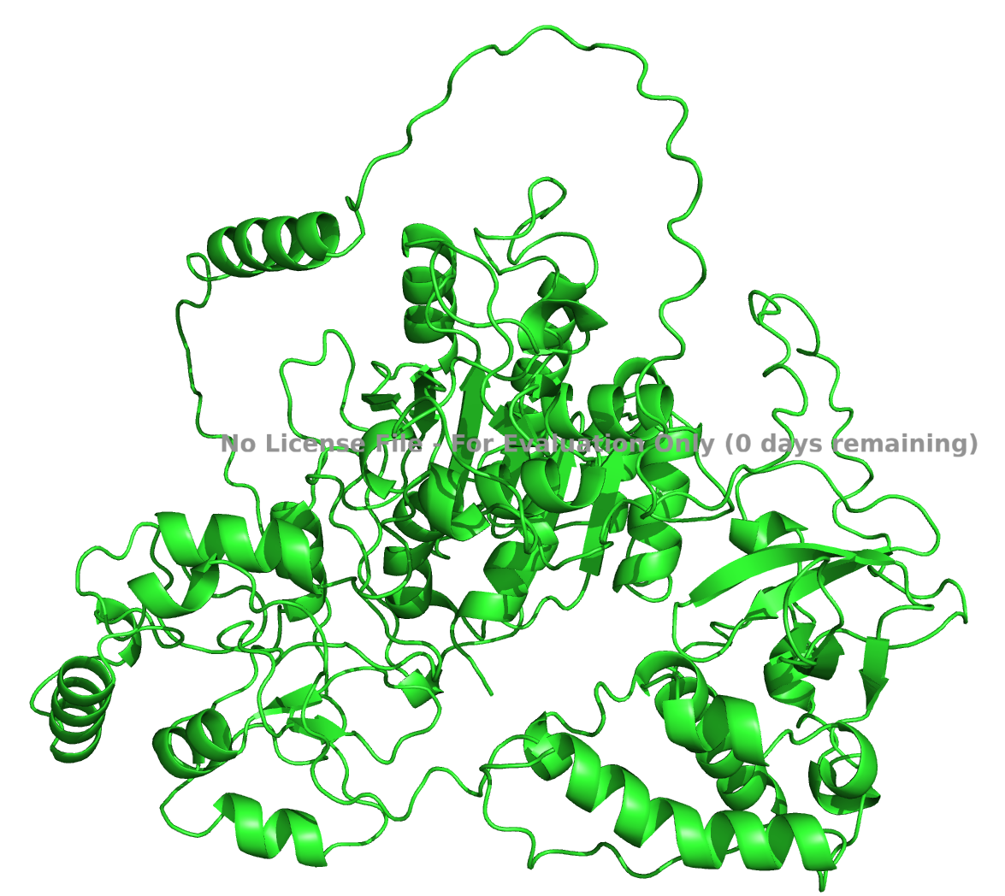
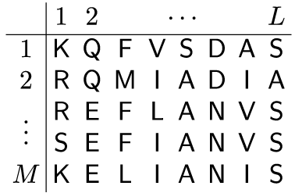
Deep learning to model mutation effects
Sequence
pLM
AlphaFold2
ESM-MSA
Sequence features
(+Blosum62, PSSM, ….)
embeddings
Node features
Evolutionary logits
Logistic
Regression
Random
Forrest
….
XGBoost
SVM
Optuna
GNN
MLP
Model 1
Model 2
Model 3
Notes:
Blosum: quantifies the likelihood of one amino acid substituting another in a protein sequence without significantly altering its function
Grantham distance is a measure that quantifies the evolutionary or physicochemical difference
PSSM: provides a detailed profile of the amino acid conservation at each position

Slide 17
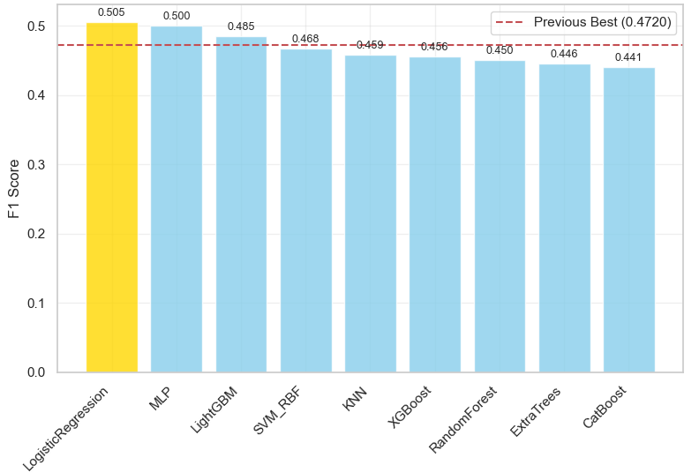
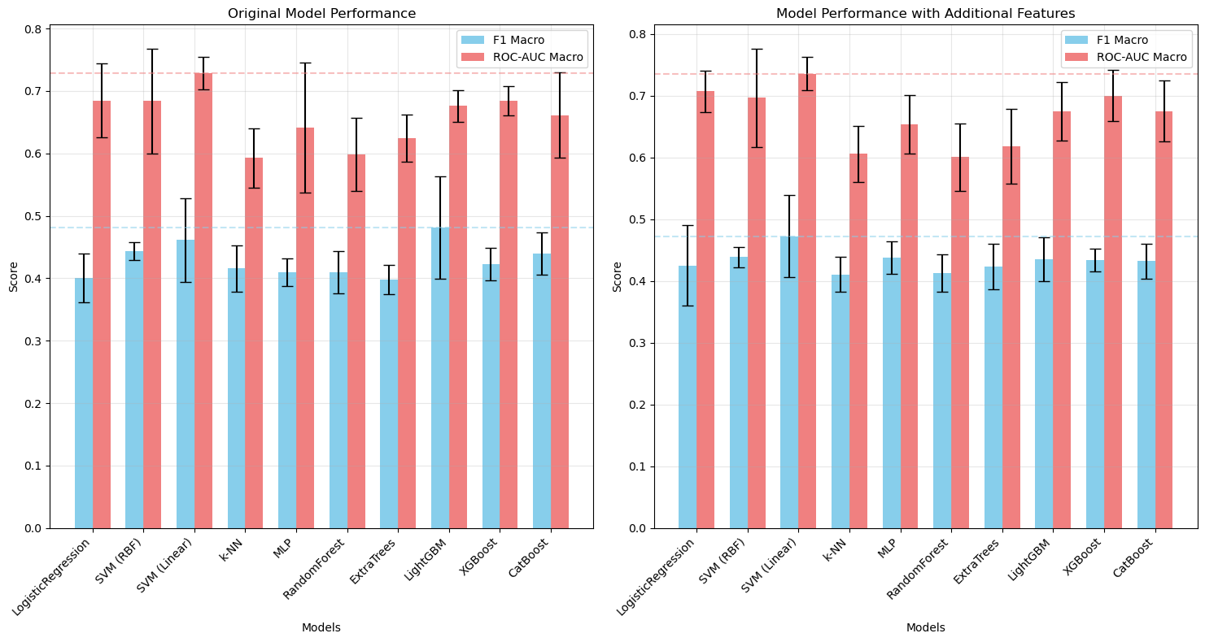
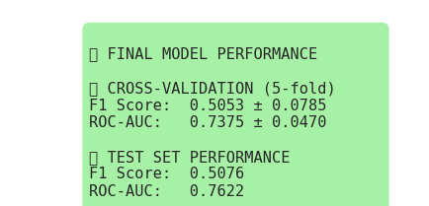
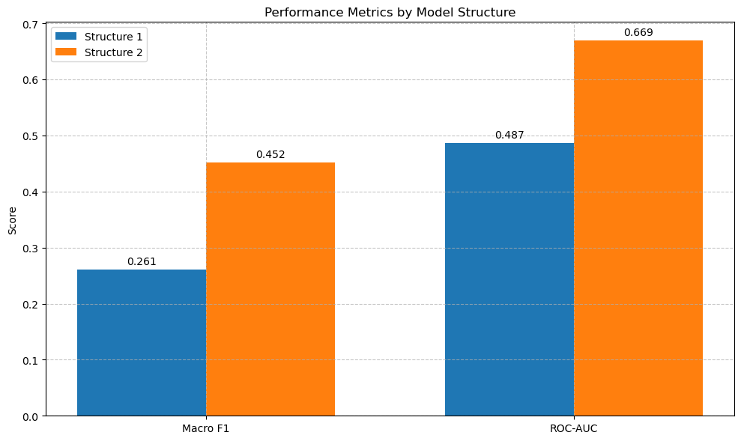
Model performance
Hyperparameter tuning
Model 1
Model 2
Model 3 (meta-learner)

Slide 18
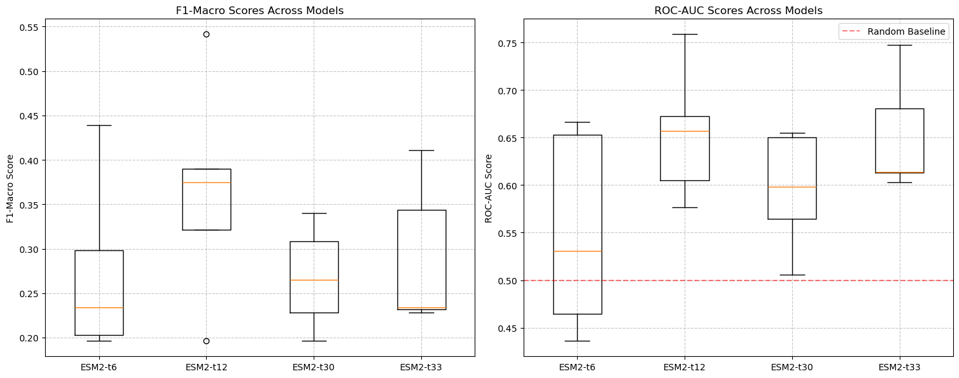
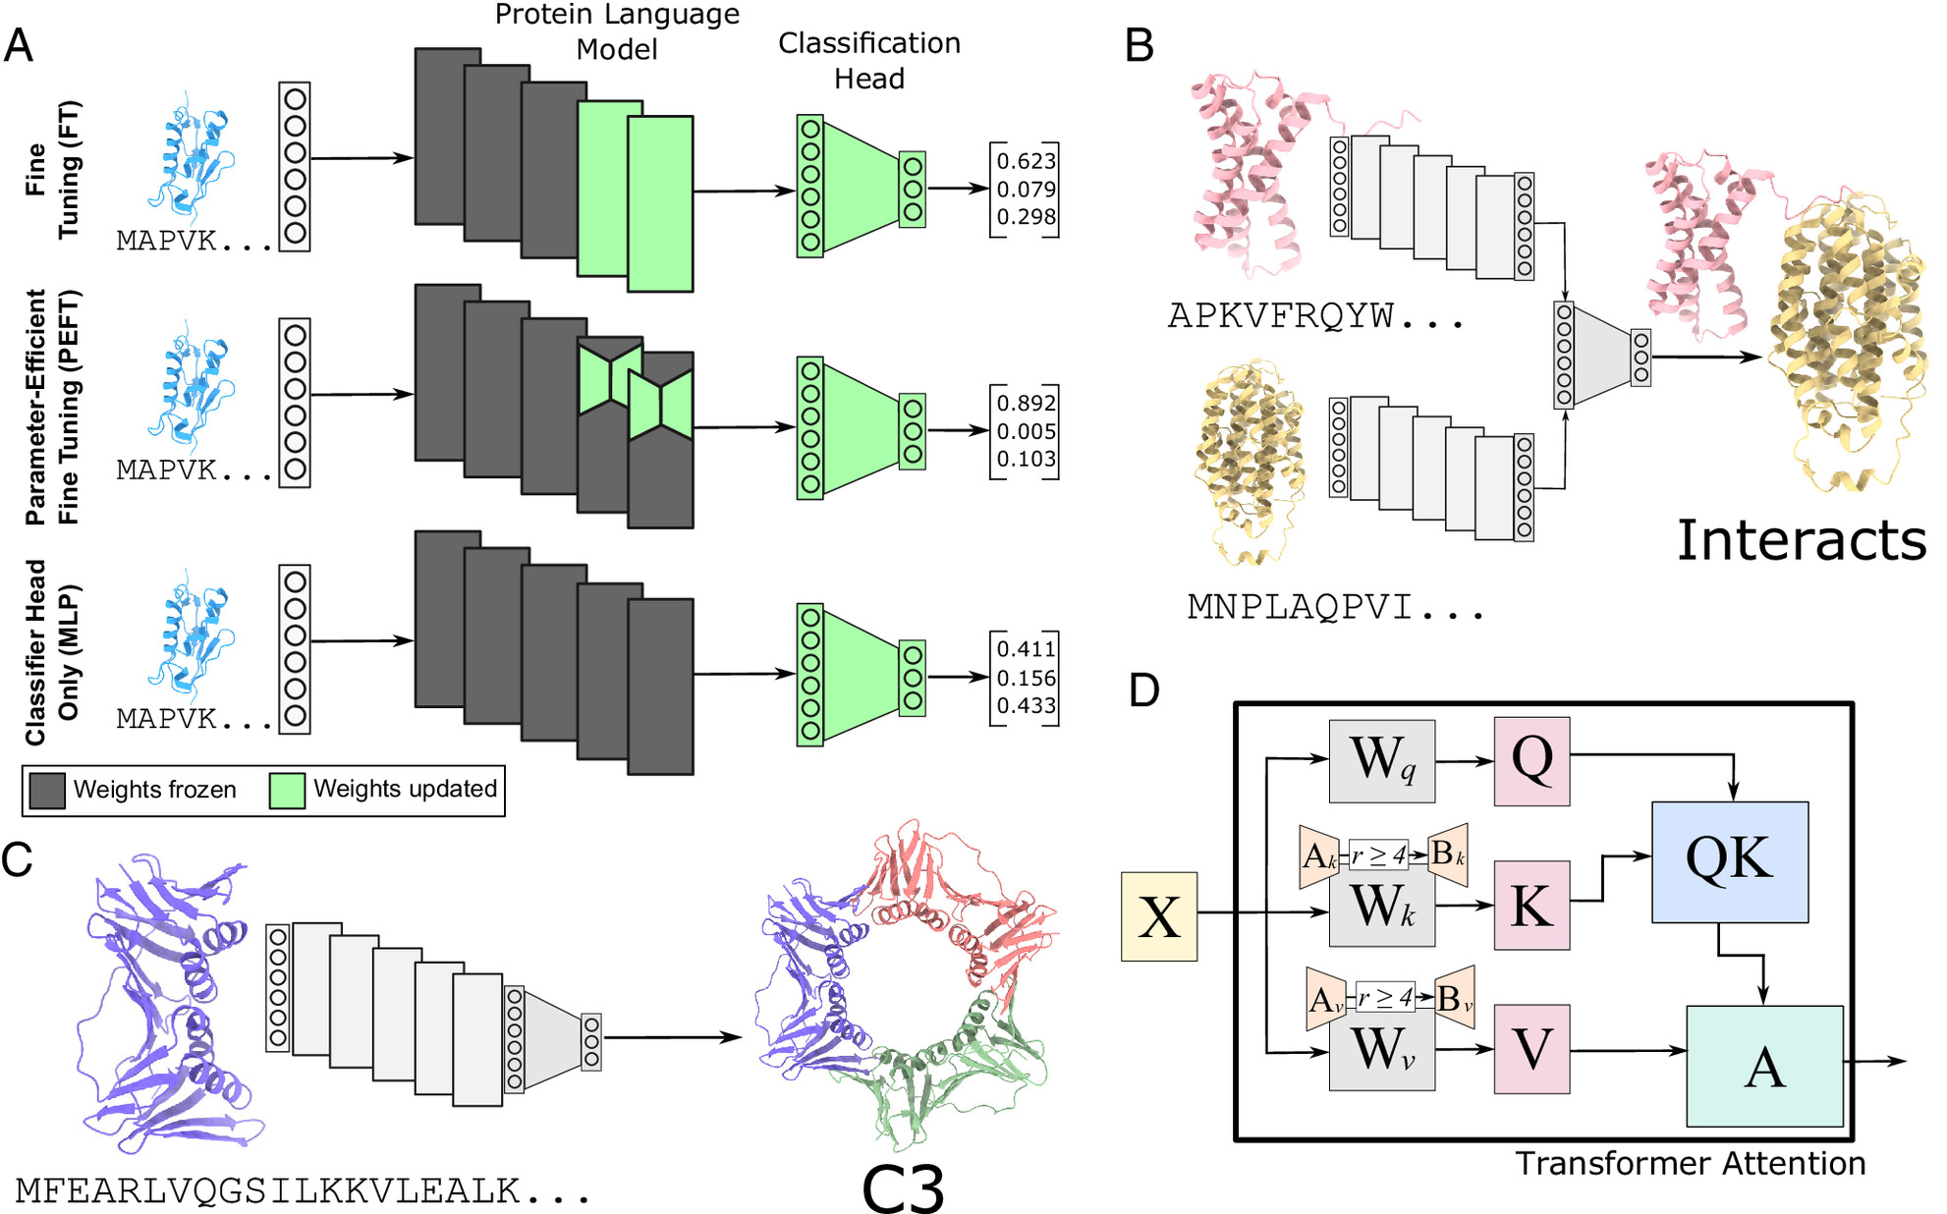

Fine tune ESM2
Fine-tune only adapters
Unfreezing last few layers (ESM2-35M)
Sledzieski et al 2024 PNAS

Slide 19
Agenda
Gene editing NGS platform
Protein engineering
mRNA sequence optimization

Slide 20


Base editing development strategy
Product
Components
Plan
Lead identification (guide+editor combo)
Editor mRNA optimization
Guide RNA optimization
Editor mRNA
guide RNA
Lead gRNA + editor mRNA
Baseline LNP establishment
Bone marrow tropism
Antibody conjugated
gRNA/mRNA/LNP
HSC targeted LNP

Slide 21


Guide screening results in hematopoietic stem cells (HSC)
HbF level by HPLC
NGS based editing efficiency
Guide design (>100)
293T editing screen (51)
HSC editing screen (24)
HbF (%)
Percent edits (%)
HSC phenotypic screen (5)
LNP delivery (2)
Candidate guide
CTX-001
Candidate guide
CTX-001
In vivo study (1)

Slide 22


Editor mRNA optimization
5’ UTR optimization → increase translation efficiency
3’ UTR optimization → stabilize transcript
Codon optimization → enhance expression

Slide 23


5’UTR optimization
HSC specific translation efficiency dataset
Optimizing 5’UTR can increase editing efficiency
Castillo-hair et al 2024 Nat Comm
Khajuria et al 2018 Cell
Notes:
First order rules: clean Kozak, few uAUGs/uORFs, limited secondary structure—work in almost every mammalian cell.
Second order: HSC specific, mTOR, RBP, microRNA biding

Slide 24


Close look at the HSC TE data
5’UTR sequence features (high vs low TE)
Notes:
High TE: first-wave protein pulse when HSCs commit or repair damage
Low TE: housekeeping ribosomal - protein transcripts

Slide 25





RNA foundation model
Chen et al 2022 Bioarxiv

Slide 26



Machine learning for 5’UTR-TE modeling
Model structure
Genetic algorithm
Metric | Value
Pearson correlation | 0.7
Spearman correlation | 0.65
MSE | 0.83

Slide 27

5’UTR candidate sequence generation
Vector structure
Source | Number | Example
Control | 3 | HBB, HBA1,Moderna
Natural UTRs (paper) | 50 | H3C12, ARL6IP4
ML generated | 50 | GCTAGAGTAGGGTCAAGAGTACCATGCGTACTAGTCTTAGGGAGTGTAAGACCTGGGTAAGGGGTAGTCGTAGGTAAGCC (fitness 0.72)
T7
5’UTR
NanoLuc
3’UTR
PloyA
T7
5’UTR
eGFP
3’UTR
PloyA
IVT
Notes:
Filters: kozak strength, uAUG (near cognate starts), RBP motif, AU rich segments
pVAX, CleanCap

Slide 28



5’UTR screening results
Flow cytometry
Luciferase assay
40
Median fluorescence intensity
35
30
25
Replicate 2
Gene editing dose response
20
Control
90
UTR1
15
75
UTR2
60
10
Editing efficiency (%)
45
5
10
15
20
25
30
35
40
30
Replicate 1
15
0
63
125
250
500
1000
2000
mRNA (ng)

Slide 29
Summary and future direction
3’UTR optimization
mRNA half life dataset (HSC SLAM-seq time course)
ML methods (RNAdegformer, 3UTR-BERT)
Biology-driven (AU motif, RBP binding, mircoRNA, secondary structure)
Codon optimization
LinearDesign → improve structure stability
tRNA tropism → codon tuning
Other consideration
Strong translation → cell stress and toxicity
Tone it down: eg. adding destabilizing motif
Notes:
Mir-142-3p
Slow codon environment: high translation → ribosome stress

Slide 30
Thank you!

